Slide 1
Principal Component Analysis (Math)

Slide 2
Outline
Dimensionality Reduction
Housing Data
Mean
Variance
Covariance
Covariance Matrix
Linear Transformation
Eigenvalues and Eigenvectors

Slide 3
Size
Number of Rooms
Number of Bathrooms
Size Feature
Number of Schools in the Area
Crime Rate
Location Feature

Slide 4

400
300
Size
200
100
1
2
3
4
5
Number of Rooms

Slide 5
400
300
Size
200
100
1
2
3
4
5
Number of Rooms

Slide 6
400
300
Size
200
100
1
2
3
4
5
Number of Rooms

Slide 7
400
300
Size
200
100
1
2
3
4
5
Number of Rooms

Slide 9
1 dimension

Slide 10
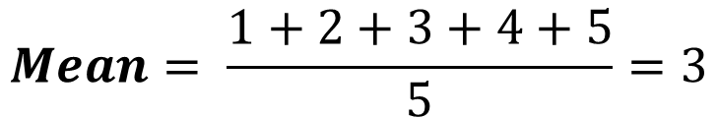
Mean
House A
House B
House C
House D
House E
1
2
3
4
5
$$Mean= \frac{1+2+3+4+5}{5}=3$$
House C is the mean

Slide 11
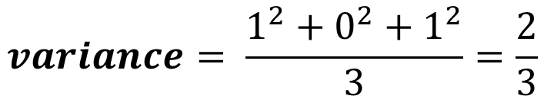
Variance
House B and House D is 1 point away from the mean
House B
1
House C
1
House D
$$variance= \frac{1^{2}+0^{2}+1^{2}}{3}=\frac{2}{3}$$

Slide 12
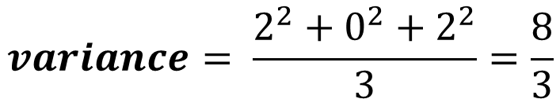
Variance
House A and House E is 2 points away from the mean
House B
1
House C
1
House D
$$variance= \frac{1^{2}+0^{2}+1^{2}}{3}=\frac{2}{3}$$
House E
House A
2
House C
2
$$variance= \frac{2^{2}+0^{2}+2^{2}}{3}=\frac{8}{3}$$

Slide 17
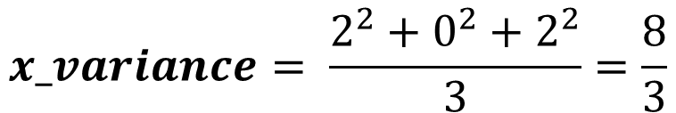
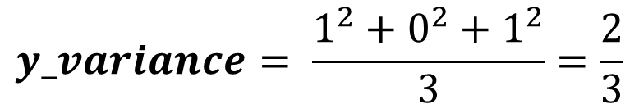
2
2
2
2
1
1
1
1
$$x_variance= \frac{2^{2}+0^{2}+2^{2}}{3}=\frac{8}{3}$$
$$y_variance= \frac{1^{2}+0^{2}+1^{2}}{3}=\frac{2}{3}$$

Slide 18
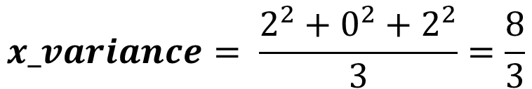
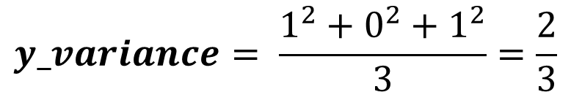
2
2
2
2
1
1
1
1
$$x_variance= \frac{2^{2}+0^{2}+2^{2}}{3}=\frac{8}{3}$$
These two data sets have the same x-variance and y-variance but they are fundamentally different
$$y_variance= \frac{1^{2}+0^{2}+1^{2}}{3}=\frac{2}{3}$$

Slide 19
2
2
2
2
1
1
1
1
$$x_variance= \frac{2^{2}+0^{2}+2^{2}}{3}=\frac{8}{3}$$
Is there another metric to tell us that these two are different?
$$y_variance= \frac{1^{2}+0^{2}+1^{2}}{3}=\frac{2}{3}$$

Slide 20









Sum of Product of Coordinates
$$\left(−2,1\right)$$
$$\left(2,1\right)$$
$$−2$$
$$+2$$
$$\left(0,0\right)$$
$$\left(−2,−1\right)$$
$$\left(−2,1\right)$$
$$+2$$
$$−2$$

Slide 21

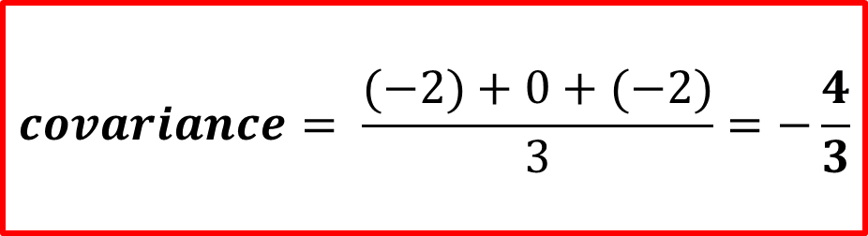









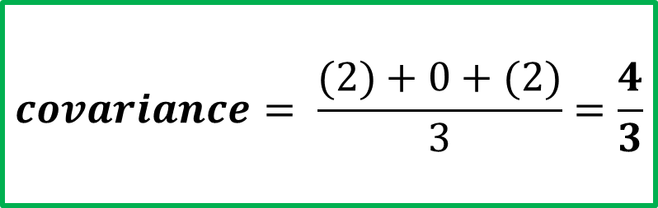
$$\left(−2,1\right)$$
$$\left(2,1\right)$$
$$−2$$
$$+2$$
$$\left(0,0\right)$$
$$\left(0,0\right)$$
$$\left(−2,1\right)$$
$$\left(−2,−1\right)$$
$$−2$$
$$+2$$
$$covariance= \frac{(−2)+0+(−2)}{3}=−\frac{4}{3}$$
$$covariance= \frac{(2)+0+(2)}{3}=\frac{4}{3}$$

Slide 22
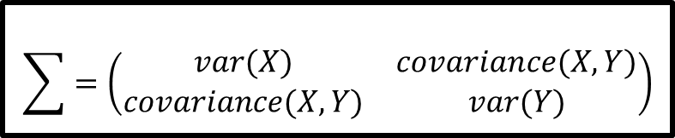
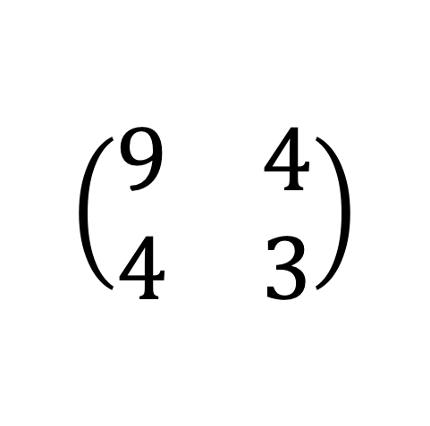
$$\sum{=\left(\begin{matrix}var(X) & covariance(X,Y) \\ covariance(X,Y) & var(Y)\end{matrix}\right)}$$
$$\left(\begin{matrix}9 & 4 \\ 4 & 3\end{matrix}\right)$$

Slide 23




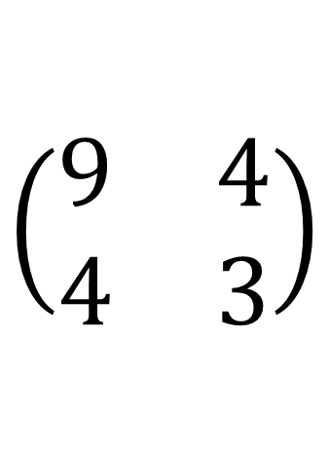








$$\left(\begin{matrix}9 & 4 \\ 4 & 3\end{matrix}\right)$$
$$(x,y)$$
$$(9x+4y, 4x+3y)$$
$$(0,0)$$
$$(9,4)$$
$$(1,0)$$
$$(4,3)$$
$$(0,1)$$
$$(4,3)$$
$$(−1,0)$$
$$(−9,−4)$$
$$(0,−1)$$
$$(−4,−3)$$

Slide 24


$$\left(\begin{matrix}9 & 4 \\ 4 & 3\end{matrix}\right)$$
$$(x,y)$$
$$(9x+4y, 4x+3y)$$
$$(0,0)$$
$$(0,0)$$
$$(1,0)$$
$$(9,4)$$
$$(0,1)$$
$$(4,3)$$
$$(−1,0)$$
$$(−9,−4)$$
$$(0,−1)$$
$$(−4,−3)$$

Slide 25
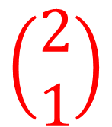
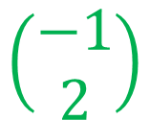



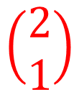

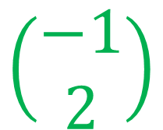
$$\left(\begin{matrix}9 & 4 \\ 4 & 3\end{matrix}\right)$$
$$\left(\begin{aligned}−1 \\ 2\end{aligned}\right)$$
$$\left(\begin{aligned}2 \\ 1\end{aligned}\right)$$
$$1$$
$$11$$
Eigenvector (direction)
Eigenvalues (magnitude)
$$\left(\begin{aligned}2 \\ 1\end{aligned}\right)$$
$$\left(\begin{aligned}−1 \\ 2\end{aligned}\right)$$
$$11$$
$$1$$

Slide 26
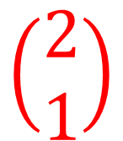


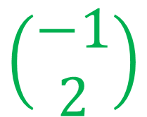
Eigenvector
$$\left(\begin{aligned}2 \\ 1\end{aligned}\right)$$
$$\left(\begin{aligned}−1 \\ 2\end{aligned}\right)$$
Eigenvalues
$$11$$
$$1$$

Slide 27
Eigenvector
(direction)
$$\left(\begin{aligned}2 \\ 1\end{aligned}\right)$$
$$\left(\begin{aligned}−1 \\ 2\end{aligned}\right)$$
Eigenvalues(magnitude)
$$11$$
$$1$$

Slide 28
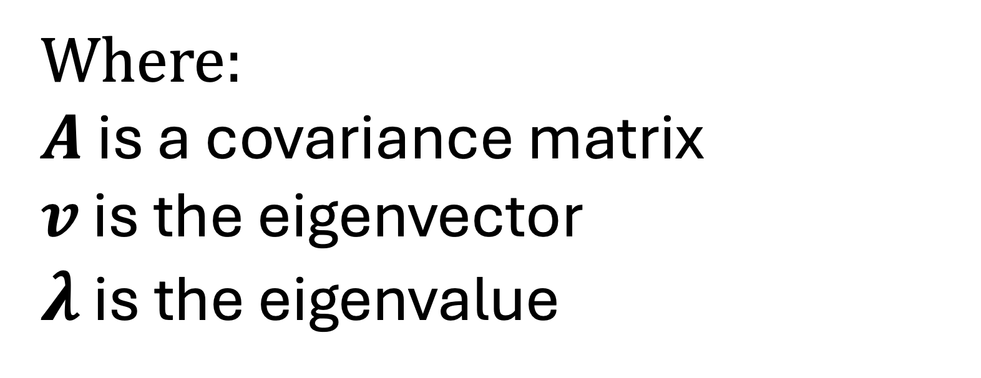
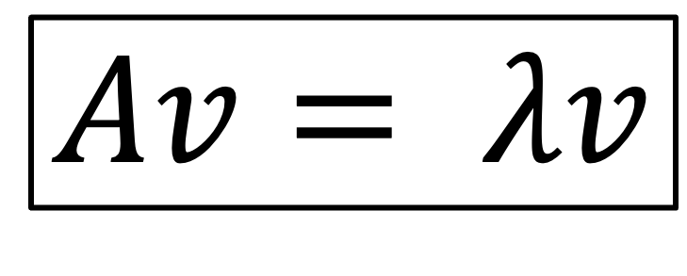
$$Av= λv$$
Where:
$A$ is a covariance matrix
$v$ is the eigenvector
$λ$ is the eigenvalue

Slide 29


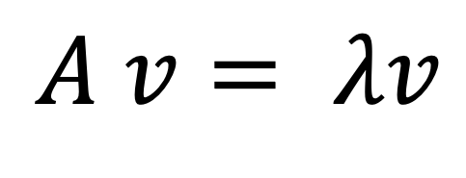
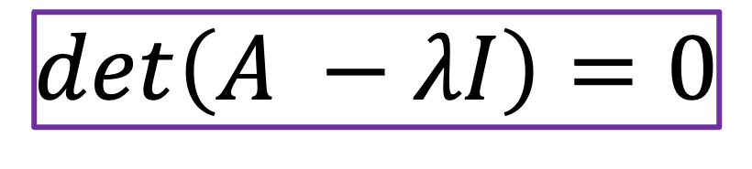
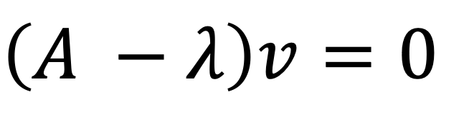
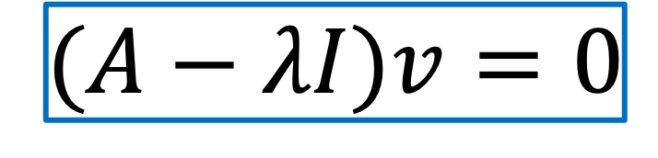
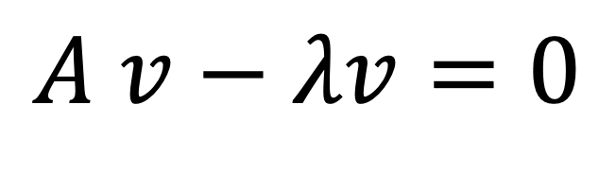
$$A v= λv$$
$$A v−λv=0$$
$$\left(A −λ\right)v=0$$
$$(A−λI)v=0$$
$$det\left(A −λI\right)=0$$

Slide 30
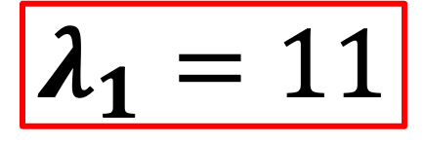
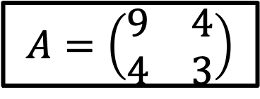
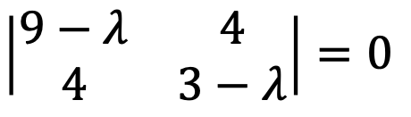

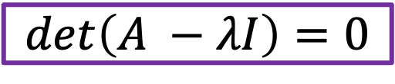
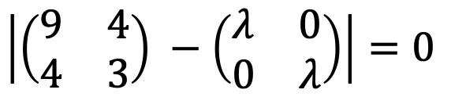
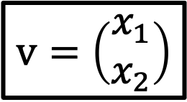

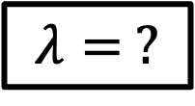

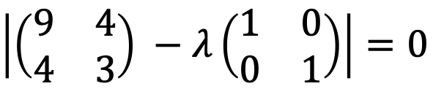

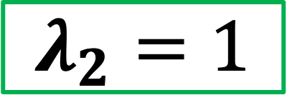
$$A=\left(\begin{matrix}9 & 4 \\ 4 & 3\end{matrix}\right)$$
$$det\left(A −λI\right)=0$$
$$\left|\left(\begin{matrix}9 & 4 \\ 4 & 3\end{matrix}\right) −λ\left(\begin{matrix}1 & 0 \\ 0 & 1\end{matrix}\right)\right|=0$$
$$v=\left(\begin{aligned}x_{1} \\ x_{2}\end{aligned}\right)$$
$$\left|\left(\begin{matrix}9 & 4 \\ 4 & 3\end{matrix}\right) −\left(\begin{matrix}λ & 0 \\ 0 & λ\end{matrix}\right)\right|=0$$
$$λ= ?$$
$$\left|\begin{matrix}9−λ & 4 \\ 4 & 3−λ\end{matrix}\right|=0$$
$$\left(9−λ\right)−\left(3−λ\right)−16=0$$
$$27−9λ−3λ+λ^{2}−16=0$$
$$λ_{1}=11$$
$$λ^{2}−12λ+11=0$$
$$λ_{2}=1$$
$$(λ−11)(λ−1)=0$$

Slide 31


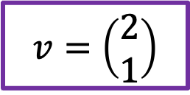
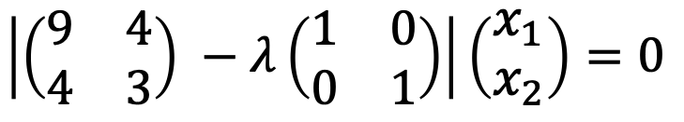
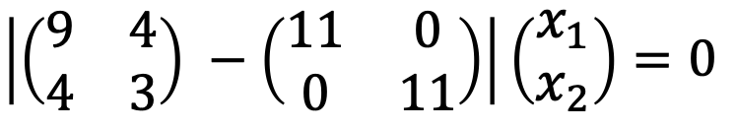


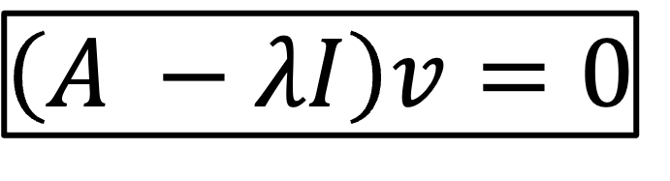


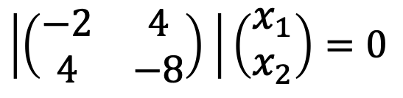
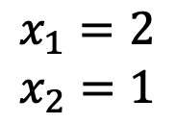
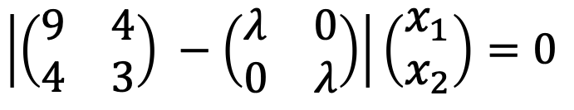


$$A=\left(\begin{matrix}9 & 4 \\ 4 & 3\end{matrix}\right)$$
$$\left(A −λI\right)v=0$$
$$v=\left(\begin{aligned}x_{1} \\ x_{2}\end{aligned}\right)$$
$$\left|\left(\begin{matrix}9 & 4 \\ 4 & 3\end{matrix}\right) −λ\left(\begin{matrix}1 & 0 \\ 0 & 1\end{matrix}\right)\right|\left(\begin{aligned}x_{1} \\ x_{2}\end{aligned}\right)=0$$
$$λ_{1}=11$$
$$\left|\left(\begin{matrix}9 & 4 \\ 4 & 3\end{matrix}\right) −\left(\begin{matrix}λ & 0 \\ 0 & λ\end{matrix}\right)\right|\left(\begin{aligned}x_{1} \\ x_{2}\end{aligned}\right)=0$$
$$λ_{2}=1$$
$$\left|\left(\begin{matrix}9 & 4 \\ 4 & 3\end{matrix}\right) −\left(\begin{matrix}11 & 0 \\ 0 & 11\end{matrix}\right)\right|\left(\begin{aligned}x_{1} \\ x_{2}\end{aligned}\right)=0$$
$$\left|\left(\begin{matrix}−2 & 4 \\ 4 & −8\end{matrix}\right) \right|\left(\begin{aligned}x_{1} \\ x_{2}\end{aligned}\right)=0$$
$$−2x_{1}+4x_{2}=0$$
$$4x_{2}=2x_{1}$$
$$2x_{2}=x_{1}$$
$$x_{1}=2$$
$$x_{2}=1$$
$$v=\left(\begin{aligned}2 \\ 1\end{aligned}\right)$$
$$4x_{1}−8x_{2}=0$$
$$4x_{1}=8x_{2}$$
$$x_{1}=2x_{2}$$

Slide 32


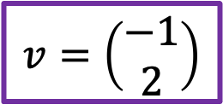
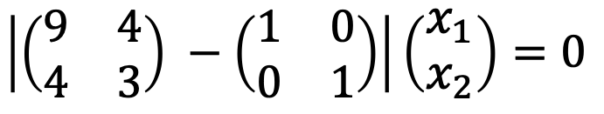




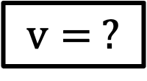
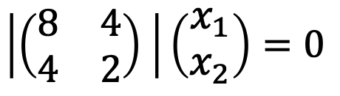
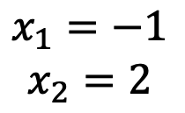


$$A=\left(\begin{matrix}9 & 4 \\ 4 & 3\end{matrix}\right)$$
$$\left(A −λI\right)v=0$$
$$v= ?$$
$$\left|\left(\begin{matrix}9 & 4 \\ 4 & 3\end{matrix}\right) −λ\left(\begin{matrix}1 & 0 \\ 0 & 1\end{matrix}\right)\right|\left(\begin{aligned}x_{1} \\ x_{2}\end{aligned}\right)=0$$
$$λ_{1}=11$$
$$\left|\left(\begin{matrix}9 & 4 \\ 4 & 3\end{matrix}\right) −\left(\begin{matrix}λ & 0 \\ 0 & λ\end{matrix}\right)\right|\left(\begin{aligned}x_{1} \\ x_{2}\end{aligned}\right)=0$$
$$λ_{2}=1$$
$$\left|\left(\begin{matrix}9 & 4 \\ 4 & 3\end{matrix}\right) −\left(\begin{matrix}1 & 0 \\ 0 & 1\end{matrix}\right)\right|\left(\begin{aligned}x_{1} \\ x_{2}\end{aligned}\right)=0$$
$$\left|\left(\begin{matrix}8 & 4 \\ 4 & 2\end{matrix}\right) \right|\left(\begin{aligned}x_{1} \\ x_{2}\end{aligned}\right)=0$$
$$8x_{1}+4x_{2}=0$$
$$8x_{1}=−4x_{2}$$
$$2x_{1}={−x}_{2}$$
$$x_{1}=−1$$
$$x_{2}=2$$
$$v=\left(\begin{aligned}−1 \\ 2\end{aligned}\right)$$
$$4x_{1}+2x_{2}=0$$
$$4x_{1}=−2x_{2}$$
$${2x}_{1}=−x_{2}$$

Slide 33
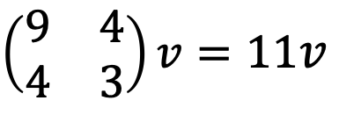

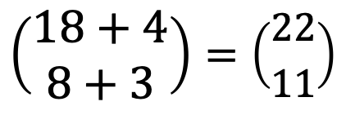
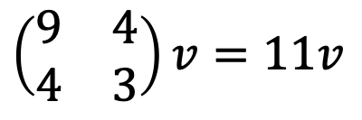
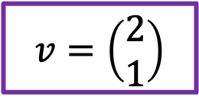



$$A=\left(\begin{matrix}9 & 4 \\ 4 & 3\end{matrix}\right)$$
$$A v= λv$$
$$λ_{1}=11$$
$$\left(\begin{matrix}9 & 4 \\ 4 & 3\end{matrix}\right)v=11v$$
$$v=\left(\begin{aligned}2 \\ 1\end{aligned}\right)$$
$$\left(\begin{matrix}9 & 4 \\ 4 & 3\end{matrix}\right)v=11v$$
$$\left(\begin{matrix}9 & 4 \\ 4 & 3\end{matrix}\right)\left(\begin{aligned}2 \\ 1\end{aligned}\right)=11\left(\begin{aligned}2 \\ 1\end{aligned}\right)$$
$$\left(\begin{aligned}18+4 \\ 8+3\end{aligned}\right)=\left(\begin{aligned}22 \\ 11\end{aligned}\right)$$
$$\left(\begin{aligned}22 \\ 11\end{aligned}\right)=\left(\begin{aligned}22 \\ 11\end{aligned}\right)$$

Slide 34







$$A=\left(\begin{matrix}9 & 4 \\ 4 & 3\end{matrix}\right)$$
$$A v= λv$$
$$λ_{2}=1$$
$$\left(\begin{matrix}9 & 4 \\ 4 & 3\end{matrix}\right)v=1v$$
$$v=\left(\begin{aligned}−1 \\ 2\end{aligned}\right)$$
$$\left(\begin{matrix}9 & 4 \\ 4 & 3\end{matrix}\right)v=1v$$
$$\left(\begin{matrix}9 & 4 \\ 4 & 3\end{matrix}\right)\left(\begin{aligned}−1 \\ 2\end{aligned}\right)=1\left(\begin{aligned}−1 \\ 2\end{aligned}\right)$$
$$\left(\begin{aligned}−9+8 \\ 8−6\end{aligned}\right)=\left(\begin{aligned}−1 \\ 2\end{aligned}\right)$$
$$\left(\begin{aligned}−1 \\ 2\end{aligned}\right)=\left(\begin{aligned}−1 \\ 2\end{aligned}\right)$$

Slide 35
Step 1: Find the center of the dataset and put the center in the origin

Slide 36

$$covariance=\left(\begin{matrix}9 & 4 \\ 4 & 3\end{matrix}\right)$$
Step 2: Calculate the covariance matrix

Slide 37




$$covariance=\left(\begin{matrix}9 & 4 \\ 4 & 3\end{matrix}\right)$$
$$\left(\begin{aligned}2 \\ 1\end{aligned}\right)$$
$$\left(\begin{aligned}−1 \\ 2\end{aligned}\right)$$
Eigenvector
(direction)
Step 3: Get the eigenvectors and eigenvalues
Eigenvalues(magnitude)
$$11$$
$$1$$

Slide 38
$$covariance=\left(\begin{matrix}9 & 4 \\ 4 & 3\end{matrix}\right)$$
$$\left(\begin{aligned}2 \\ 1\end{aligned}\right)$$
$$\left(\begin{aligned}−1 \\ 2\end{aligned}\right)$$
Eigenvector
(direction)
Step 4: Choose the most important eigenvector and eigenvalue
Eigenvalues(magnitude)
$$11$$
$$1$$

Slide 39
Step 5: Project the data into the eigenvector. We now have converted our data from two dimension to one dimension

